Slide 1

Agenda
Poverty in America
How to make the problem worse
Who is responsible to solve the problem?
Principles of effective programs
Examples of effective programs
True Charity Resources
Notes:
The intent of this slide deck is not to run all of the slides, but rather to pick and choose the right framings for your audience by section.

Slide 2
Poverty in America

Slide 3
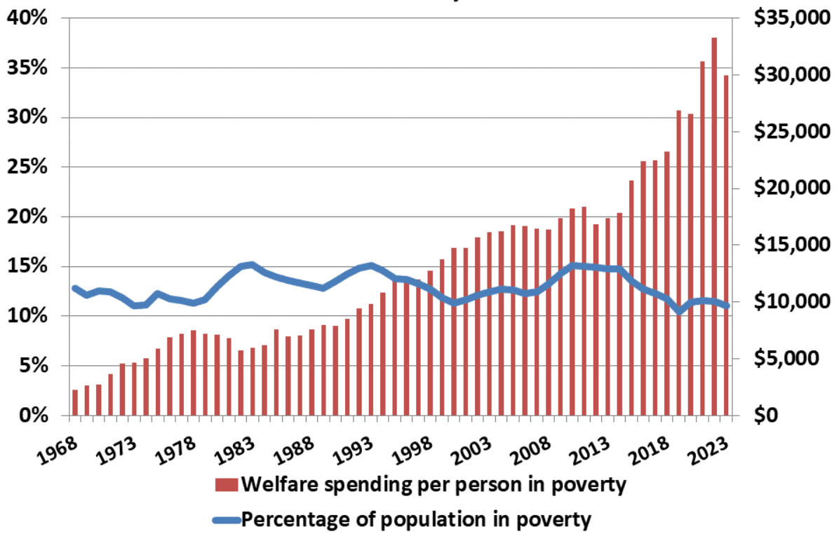
Increasing Welfare Spending Hasn’t Budged Poverty Rates
Notes:
Inflation adjusted spending per person in poverty (note that not all of this goes directly to the recipients – a significant amount covers administration). Source: https://federalsafetynet.com/poverty-and-spending-over-the-years-2/

Slide 4
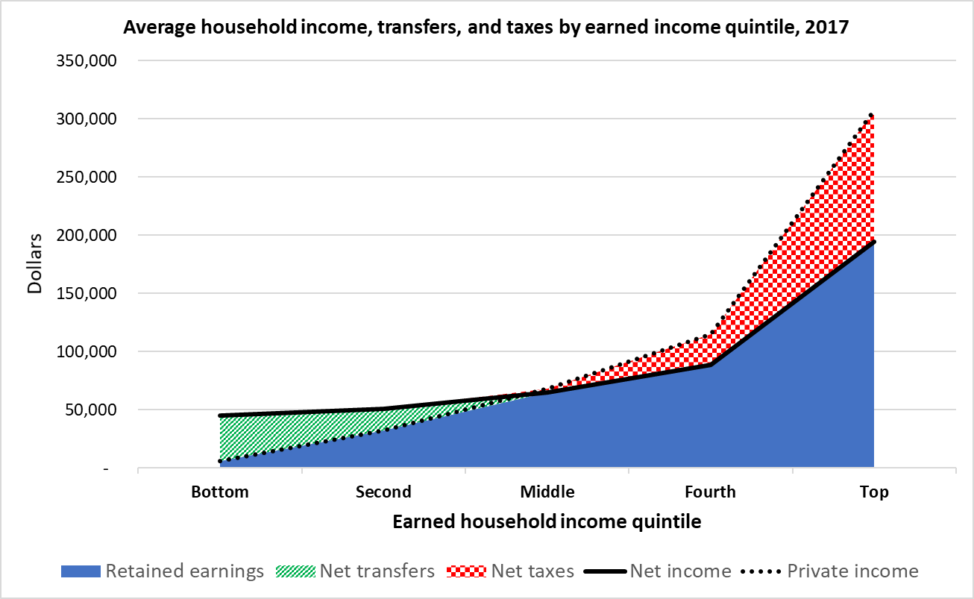
Transfers Significantly Decrease Material Deprivation
Notes:
Source: Economic Inequality: Are We Measuring It Right and What Does It Mean? | Cato Institute

Slide 5
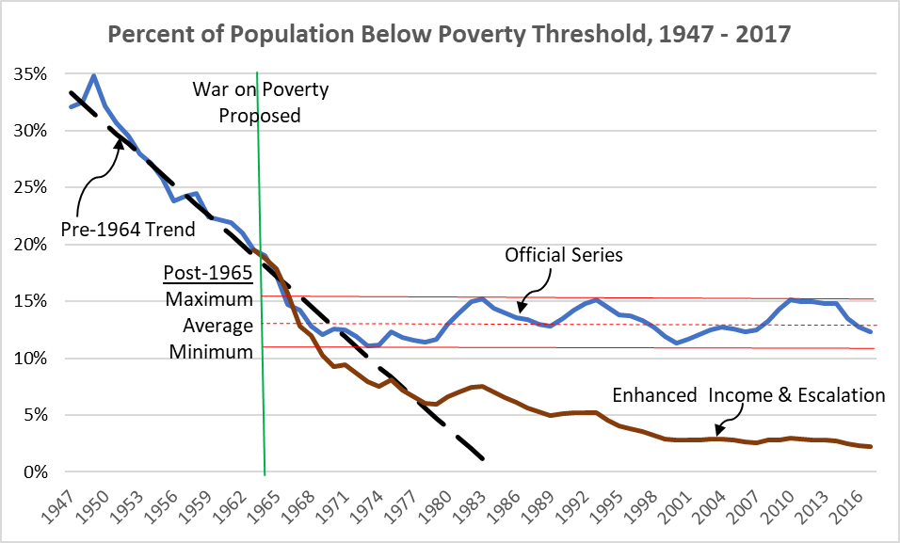
Transfers Reduce the Number of Truly Poor People
Notes:
Explanation: Poverty rates don’t include transfer income. Once you add them, the number of people truly subsisting below the poverty line drops significantly.
Source: Economic Inequality: Are We Measuring It Right and What Does It Mean? | Cato Institute

Slide 6
Yet, poverty persists
65% of working-age people in poverty did not work for a single week in 2023.
34% of children born in poverty will remain there throughout their lives.
Disability claims have significantly outpaced population growth.
Church attendance among the poor is at a record low.
Social connectedness is much lower for people with lower incomes.
Poor children are less likely to benefit from the “two-parent privilege.”
“Deaths of despair” from suicide and substance abuse are at record highs.
Notes:
Sources and commentary available here: https://fee.org/articles/beyond-the-welfare-state/

Slide 7

The Problem
In American poverty, the problem of alienation is greater than the problem of deprivation.

Slide 8
Making the Problem Worse

Slide 9
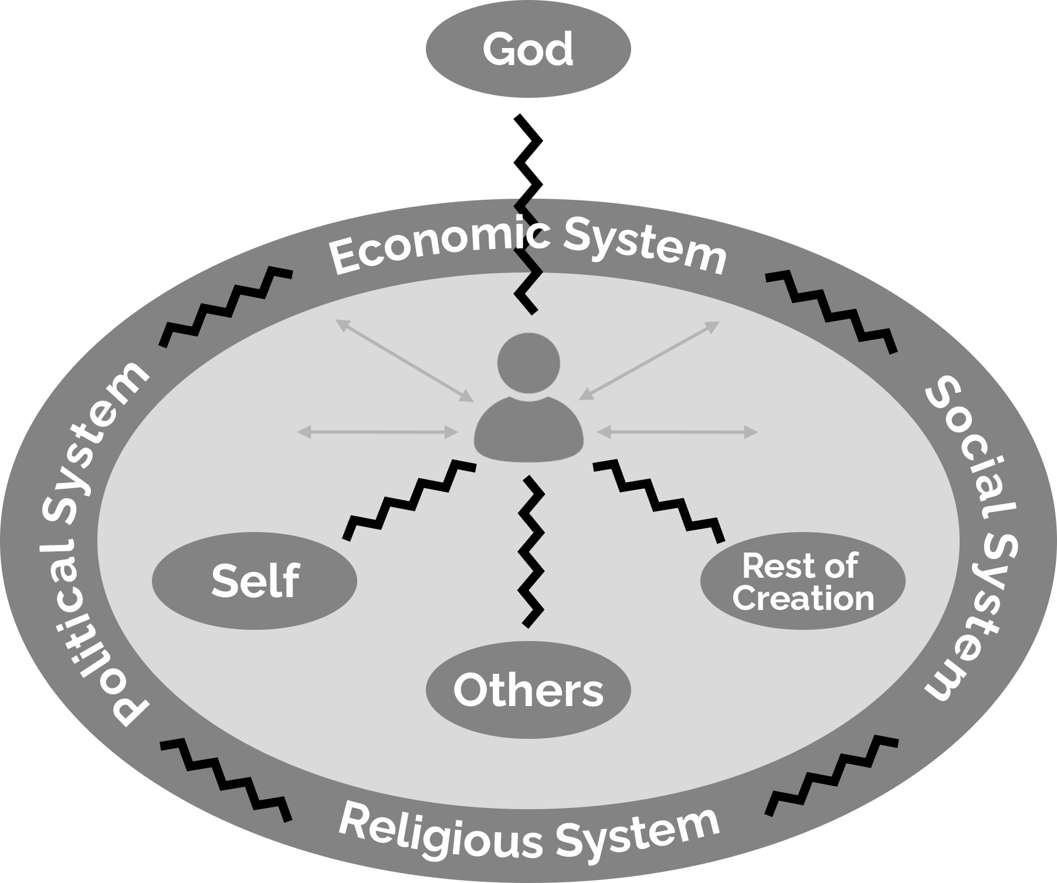
Counter-productive solutions:
Ignoring relational problems
Wholeness is found in proper functioning of four foundational relationships, not just material prosperity
Notes:
When everything functions properly, we are in right relationship with God, ourselves, others, and the material creation. These relationships are supported or undermined by systems. The breakdown of these relationships results in all human problems, including poverty.

Slide 10
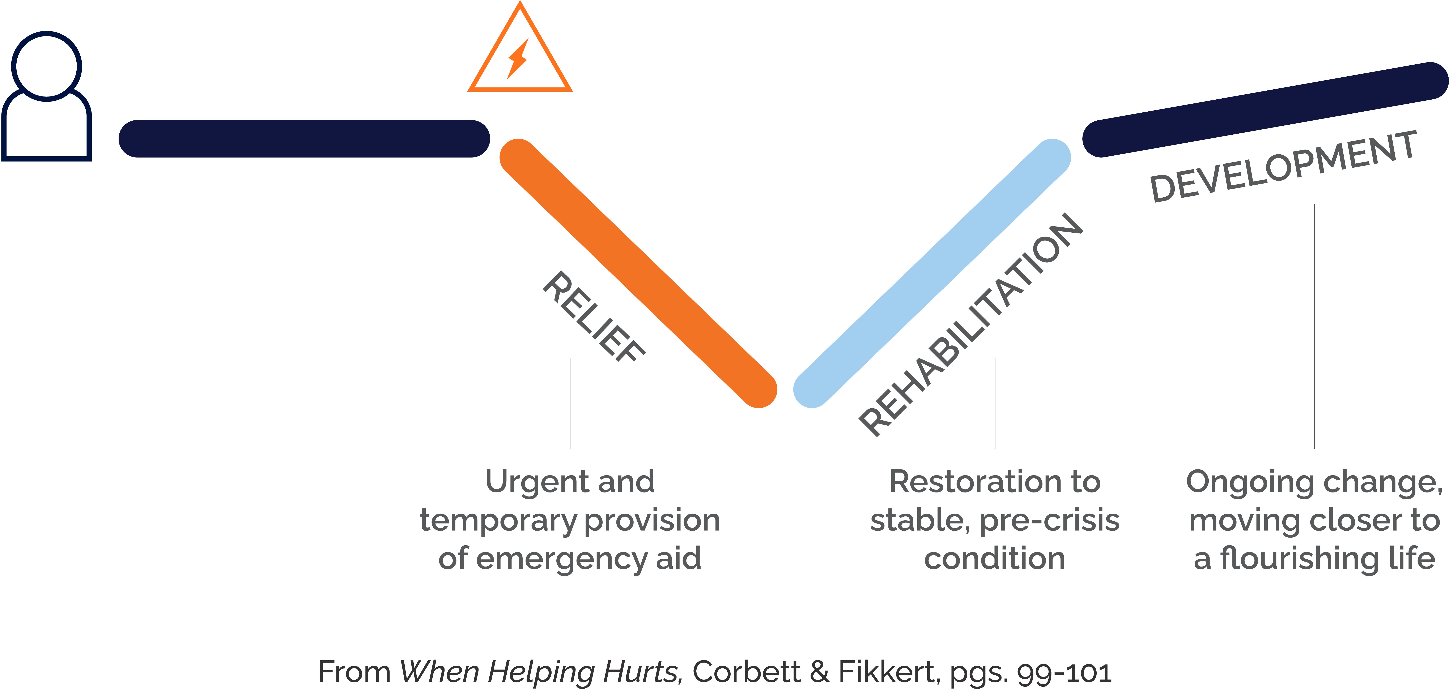
Counter-productive solutions:
Perpetual Crisis Relief
Leaving poverty for good requires development, not just crisis relief

Slide 11

Counter-productive solutions:
Doing for people what they can do for themselves
One-way giving should be limited to “crisis” situations
5 Steps to Dependency
Appreciation
Anticipation
Expectation
Entitlement
Dependency
ROBERT LUPTON
40+ year poverty-fighting vet
Author of Toxic Charity
& Charity Detox

Slide 12
Who is Responsible for Solutions?

Slide 13

The Church has a duty to care for the poor
1 John 3:17 ”But if anyone has the world's goods and sees his brother in need, yet closes his heart against him, how does God's love abide in him?”
James 1:27 “ Religion that is pure and undefiled before God the Father is this: to visit orphans and widows in their affliction, and to keep oneself unstained from the world.”
Matthew 25:40 “And the King will answer them, ‘Truly, I say to you, as you did it to one of the least of these my brothers, you did it to me.’”

Slide 14
Civil Society is best equipped to take lead
Three sectors for solutions
Government
All sectors play a role, and have different specialties
Business
Civil
Society
The voluntary sector is best equipped to take the lead in poverty alleviation
Notes:
The government wields force, business wields the profit motive and price system, and civil society has “love.”
More explanation is available here: https://fee.org/articles/beyond-the-welfare-state/

Slide 15
Why are voluntary solutions superior?
REAL SOLUTIONS ARE
Root Issue Oriented
Individually Tailored
Relational
Transformational
INSTITUTIONAL SOLUTIONS ARE
Symptom Oriented
Standardized
Bureaucratic
Transactional

Slide 16
Characteristics of Effective Solutions
Notes:
Note: There are multiple, harmonious ways to categorize principles of effective charity.
7 Marks comes from a historical view, with a focus at the level of the caseworker
3 Pillars is focused on missing links in our current moment, with a focus at the level of program design.
6 Principles to Disrupt Chronic Poverty is more comprehensive.
Use whichever framework you prefer, but avoid using all three.

Slide 17

7 Marks of Effective Charity
Affiliation
Bonding
Categorization
Discernment
Exchange
Freedom
God
Notes:
Affiliation: Effective compassion begins by reconnecting people to their families, neighbors, and community institutions rather than bypassing them with impersonal services.
Bonding: Helpers must build real, personal relationships with those they serve so that care is rooted in trust and mutual understanding.
Categorization: Compassion requires distinguishing between different kinds of need so that help is tailored appropriately rather than delivered as a one‑size‑fits‑all handout.
Discernment: Wise charity evaluates a person’s situation carefully to avoid enabling harmful behavior and to ensure help truly helps.
Exchange/Employment: Long‑term restoration depends on connecting people to work, which builds dignity, responsibility, and independence.
Freedom: Assistance should protect personal liberty and avoid creating dependency or coercive systems that trap people in poverty.
God: Historically effective compassion recognizes the spiritual dimension of human need and invites transformation, not just material relief.

Slide 18

Pillars of Effective Charity
Voluntarily Funded: resourced by compassionate people

Slide 19
Pillars of Effective Charity
Challenge Oriented: empowering recipients to help themselves

Slide 20
Pillars of Effective Charity
Outcome Driven: making a measurable difference

Slide 21
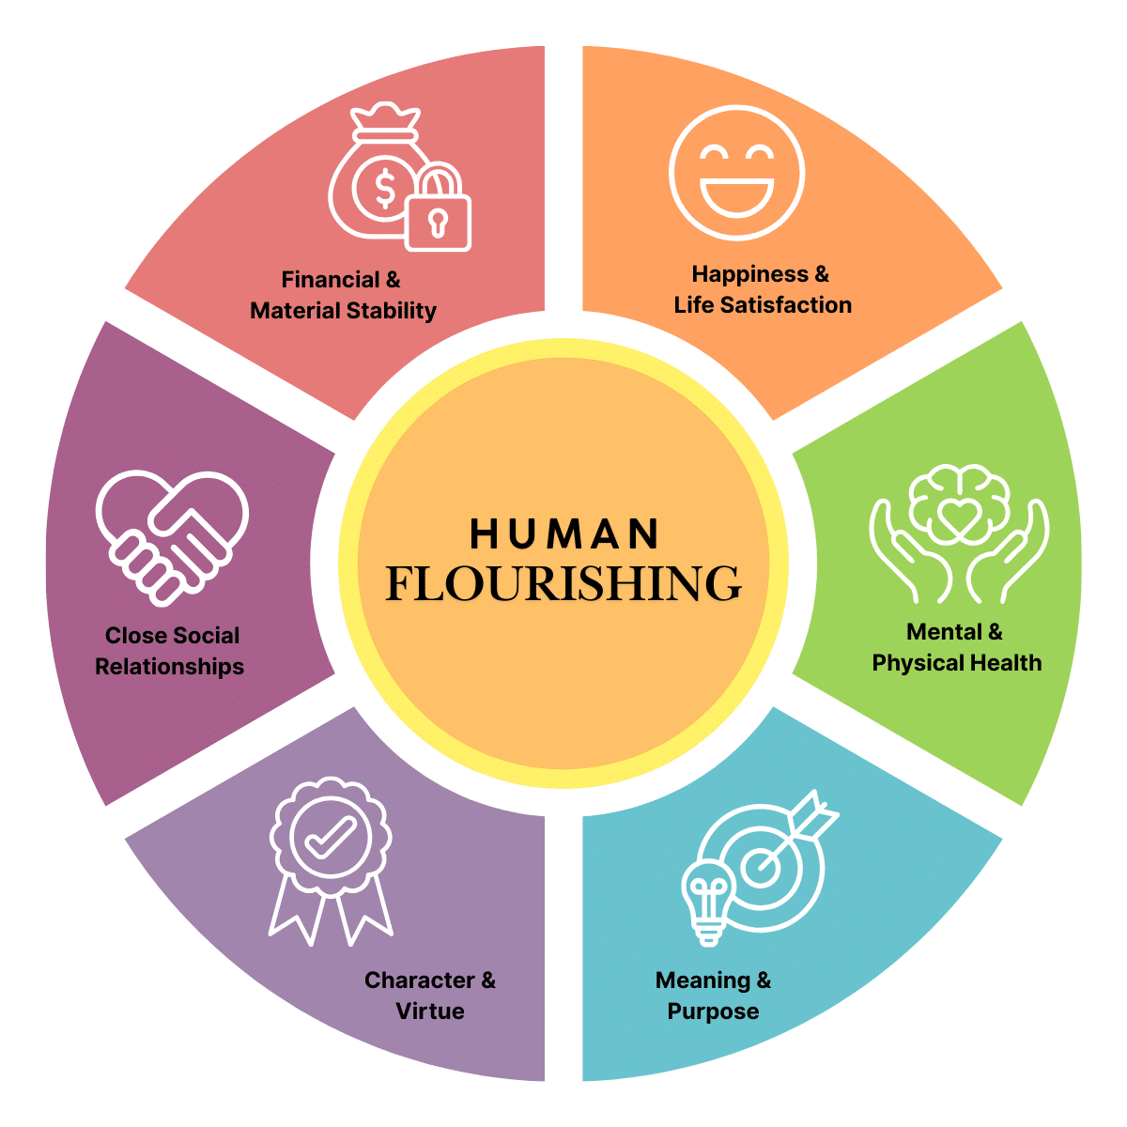
6 Best Practices to Disrupt Chronic Poverty
1. A Holistic Perspective: People are created in the image of God with physical, intellectual, emotional, and spiritual components.
Harvard Human Flourishing Domains

Slide 22
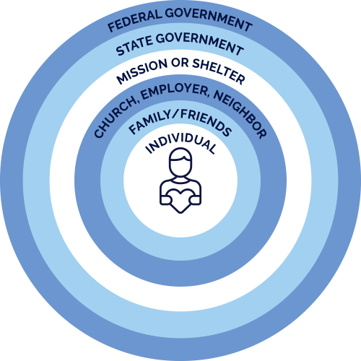
6 Best Practices to Disrupt Chronic Poverty
2. The Right Agent: People closer to the problem do their part before people and institutions father away step in.
Subsidiarity: solving problems at the most local level possible

Slide 23
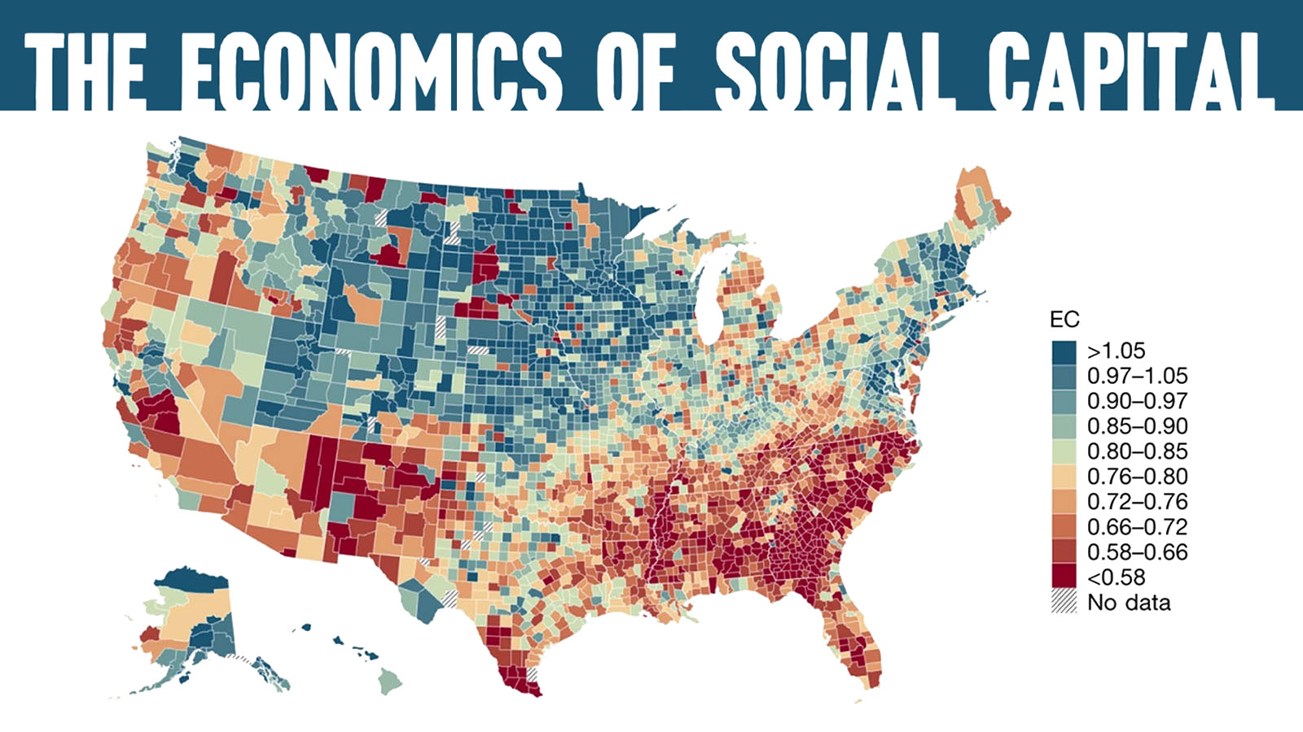
6 Best Practices to Disrupt Chronic Poverty
3. A Relational Approach: Build genuine, reciprocal relationships with people in poverty, and connect them to new ones.
Economic Connectedness by County – Raj Chetty et al.

Slide 24
6 Best Practices to Disrupt Chronic Poverty
4. A Developmental Goal: Empower people to lead their own solutions by leveraging their capacity.

Slide 25
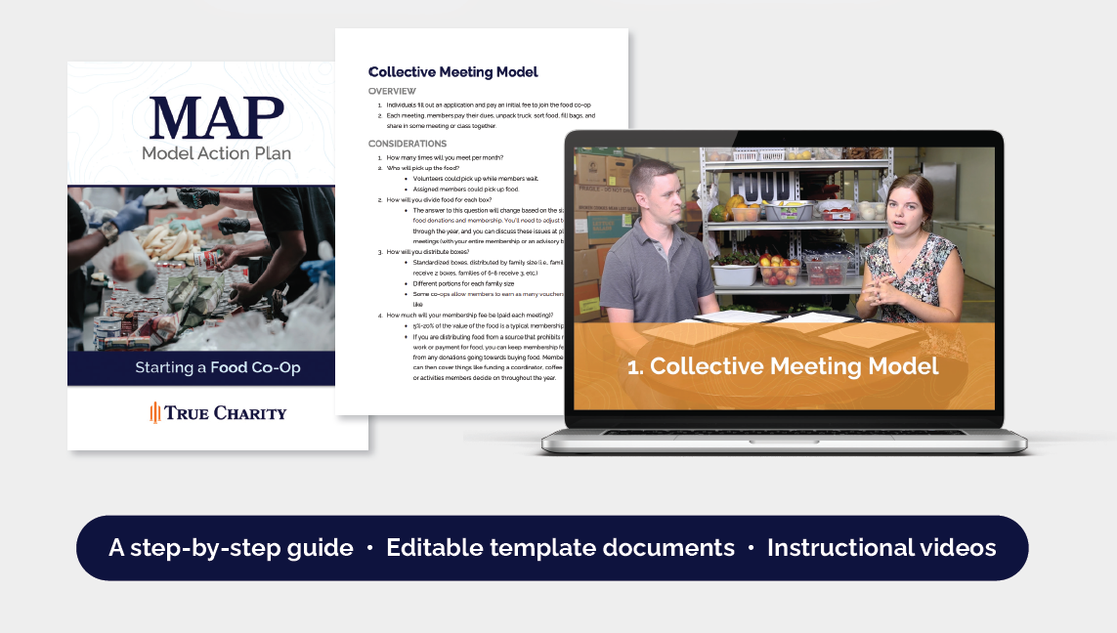
6 Best Practices to Disrupt Chronic Poverty
5. Evidence-Based Practice: Start with best practices and measure outcomes to see if they work for you.
Model Action Plans: Detailed descriptions of innovative charitable models.

Slide 26
6 Best Practices to Disrupt Chronic Poverty
6. Systemic Thinking: Acknowledge that not all dysfunction is at the individual level, and address systems when they are the obstacle to success.
A System: a set of interconnected components that form a unified whole

Slide 27
Examples of Effective Solutions

Slide 28

More Effective Models
CHRISTMAS MARKETS
CONCEPT: Charge a 10-50% of retail price for new Christmas gifts
STRENGTH: Friends and family are empowered to support their own relations as much as possible.
Notes:
More Information: https://www.truecharity.us/is-making-the-switch-to-a-christmas-market-worth-it-hear-from-two-network-members-about-their-experiences/

Slide 29
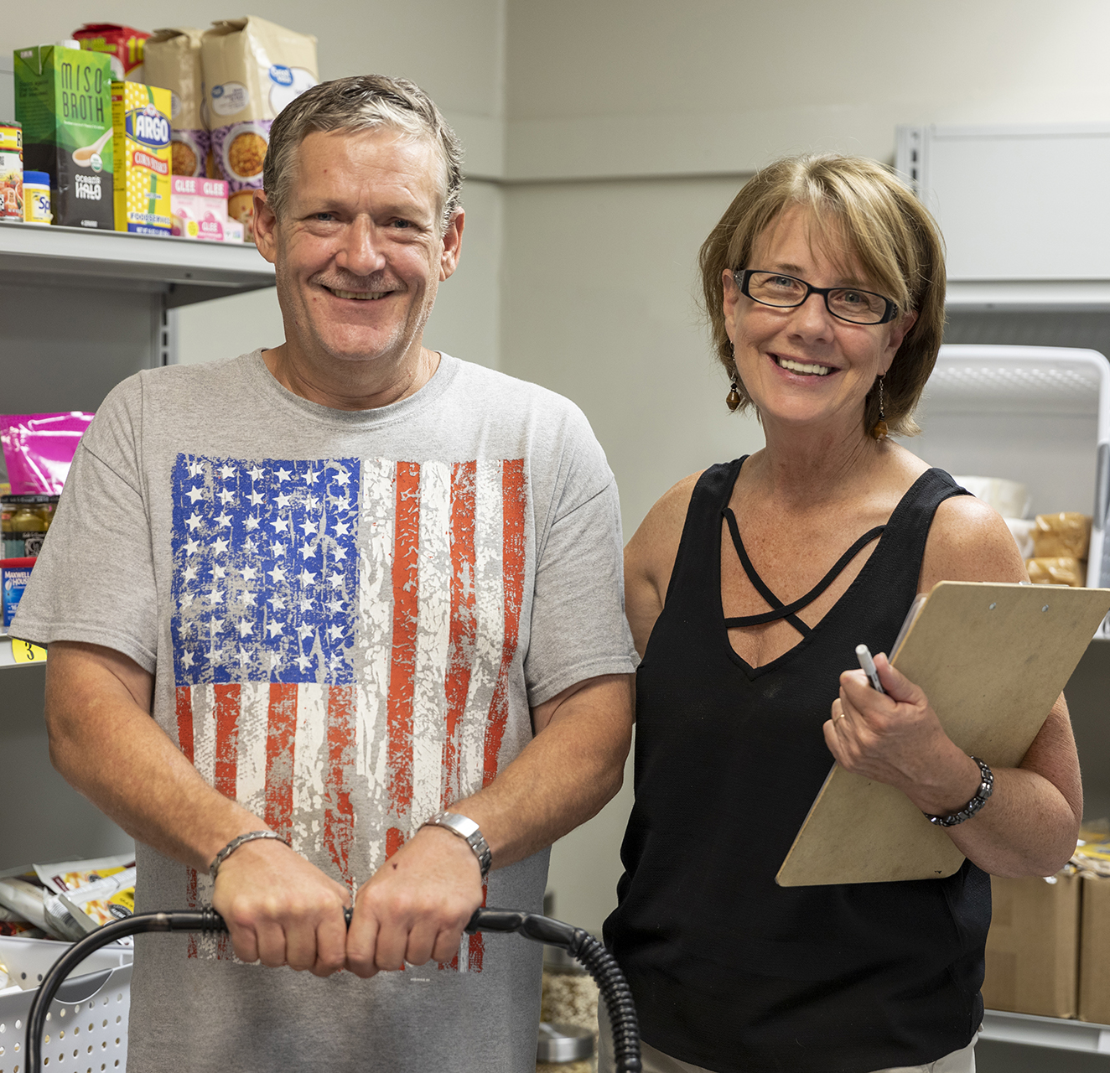
More Effective Models
FOOD CO-OP
CONCEPT: Repurpose a food pantry into a club, where members pay dues
STRENGTH: Building solidarity among the poor. People in poverty tend to be isolated from their own neighbors.
Notes:
More Information: https://www.truecharity.us/how-to-turn-your-food-pantry-into-a-community-co-op/

Slide 30

More Effective Models
MENTORSHIP PROGRAM
CONCEPT: Deliberate 1-1 or group meetings with people who are and aren’t in poverty.
PRINCIPLE: People in poverty need to build new relationships with people who aren’t – “bridging social capital.”
Notes:
More Information: https://www.truecharity.us/3-ways-to-empower-mentees/

Slide 31

More Effective Models
EARN-IT PROJECTS
CONCEPT: Providing services to guests and neighbors at a discounted rate in exchange for volunteer work.
STRENGTH: Work awakens worth – it respects people’s dignity.
Notes:
More Information: https://www.truecharity.us/whats-the-difference-between-an-earn-it-project-and-a-social-enterprise/

Slide 32
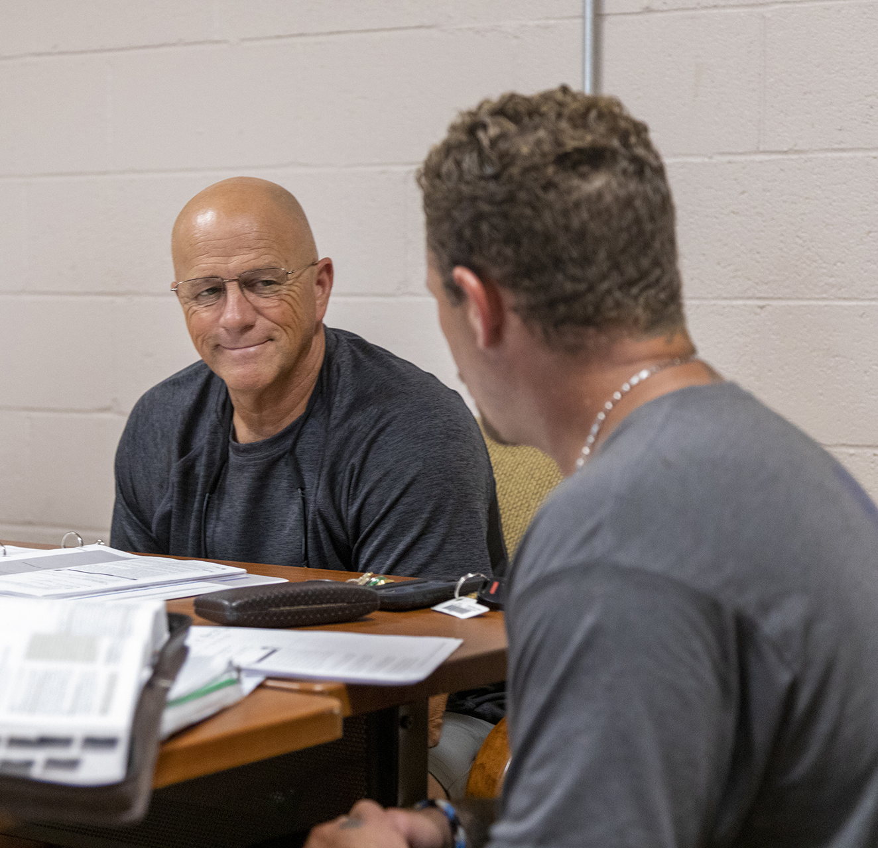
More Effective Models
AWARD FOR PERFORMANCE
CONCEPT: Instead of a giveaway, concentrate the resources on people who have demonstrated the most persistence or progress in case management.
STRENGTH: Rewards progress rather than insistent storytelling.
Notes:
More Information: https://www.truecharity.us/how-one-idaho-based-program-honors-achievement-at-christmas-time-and-beyond/

Slide 33

More Effective Models
GOAL-SETTING BENEVOLENCE
CONCEPT: A church benevolence program exchanges assistance for basic case management and goal setting
STRENGTH: Do whatever you can to help people not need you in the future
Notes:
More Information: https://www.truecharity.us/right-here-right-now-how-one-church-benevolence-program-connects-to-those-in-need/
https://www.truecharity.us/resource-review-helping-without-hurting-in-church-benevolence/

Slide 34
Resources from True Charity

Slide 35
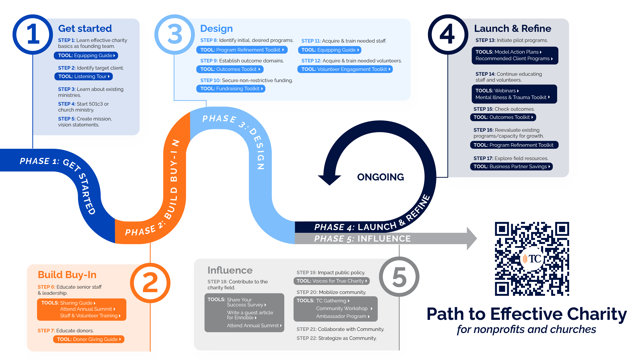
True Charity can help.

Slide 36
Model Action Plan Library

Slide 37
Model Action Plan Library
Benevolence & Financial Assistance
Case Management & Goal Setting
Childcare Solutions
Christmas Market
Developmental Classes
Earn-It Project
Emergency Shelter
Engaging the Unsheltered Homeless
Food Co-Op
Mentoring
Residential Life Transformation
Transitional Housing
Transportation Solutions
Youth Earn-It Project

Slide 38
Toolkit Library
Church Mobilization
Coalition Building
Fundraising 101
Mental Illness & Trauma
Outcomes Measurement
Program Refinement
Volunteer Engagement
Municipal Policy

Slide 39

Access a free trial at truecharity.us/join

Slide 40


Slide 41



Take the next step!
Join the Network
Attend a member orientation
Take the quiz
truecharity.us/join
truecharity.us/path

